Slide 1
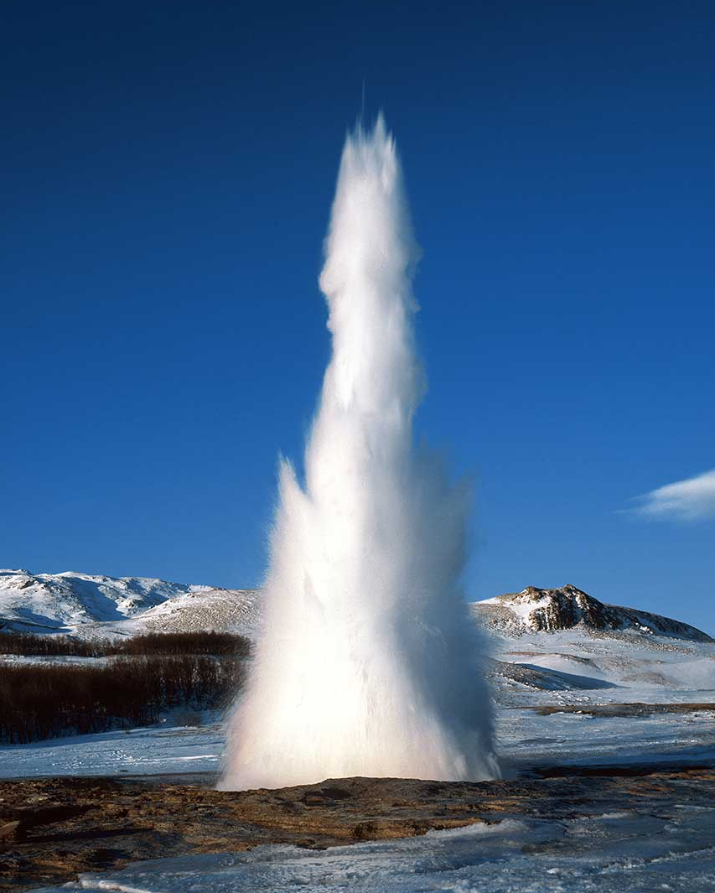
Iceland Geography Trip 2023
19th – 22nd July 2023
Open to all Year 8-Year 13 pupils.
Sign up via the school newsletter for more information

